Slide 1
How to Architect Azure for Insights & Analytics
Mehmet Bakkaloglu
Business Insights & Analytics, Hitachi Consulting
SQLBits Conference, London, Feb 2018

Slide 2
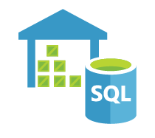



















Vast array of Platform-as-a-Service components
Azure Blob Storage
Azure Data Lake Store
Azure SQL Data Warehouse
Azure Database
Cosmos DB
Azure Analysis Services
Machine Learning
PowerApps
Azure Data Lake Analytics
Azure Data Factory
Azure Logic Apps
Azure Web App – Web Job
Azure Event Hub
Azure IoT Hub
Stream Analytics
Azure Functions
Azure Runbook
Flow
Given the differences in functionality, cost, practicality, how to choose the right components, bearing in mind the needs of the business now and in the future?
Custom .NET Components

Slide 3
This is a wide topic that depends on the business and type of data…
So we will use a real-world Azure BI implementation over 2 years as a vehicle for this discussion, and look at the decisions made along the way…

Slide 4
Contents
Evolution of Azure Architecture at a Water Company client:
Feb 2016
Aug 2016
Mar 2017
Dec 2017
Add text here
Phase 1
Basic Architecture
Orchestration tools
Storage options
Phase 2
IoT data: Near real-time analytics
Web App for data entry
Phase 3
Annotations & Reference Data Management
Notifications
Connect to non-on-premise sources
Further decisions
Environments
Coordination (multiple ELT on Azure DW)
PowerBI options

Slide 5
Phase 1 (Feb 2016 – Jul 2016)

Slide 6

First Phase: Basic Architecture Feb 2016 – Jul 2016
On-premise
Cloud
Data Sources
Gateway Server
SQL Server
Attunity SQL Server Oracle Connector CDC
Ellipse
Azure Blob Storage
Azure SQL Data Warehouse
Dashboards
FFP
Up to 8 refreshes per day
Leak Detection
CRM
Polybase
Waste Water ODI
CAB
GWater
SSIS
Customer Leakage
Azure Data Factory

Slide 7
Key Decisions
2. Blob Store or Data Lake Store?
3. Azure Data Warehouse or Database?
On-premise
Cloud
Data Sources
Gateway Server
SQL Server
Attunity SQL Server Oracle Connector CDC
Ellipse
Azure Blob Storage
Azure SQL Data Warehouse
Dashboards
FFP
Up to 8 refreshes per day
Leak Detection
CRM
Polybase
Waste Water ODI
CAB
GWater
SSIS
Customer Leakage
4. How to upload to database?
1. How to upload data to cloud?
Azure Data Factory
5. Which orchestration tool to use?

Slide 8
1. How to upload data to Azure
SSIS – Azure Blob Upload Task / Azure Data Lake Store File System Task
+ Can connect to various sources, do transformations, conditional tasks etc.
– Burden of having to manage software / server
ADF Copy
+ PaaS
– Data Management Gateway required – may not be allowed by some organisations due to security restrictions
– It’s a tool for data movement and orchestration – some limitations in ability to implement logic (ADF v2 has more features)
Other options:
AZCopy – command-line utility
BCP – suitable for small files
Custom .NET App
Other proprietary software (e.g. Mulesoft)

Slide 9
2. Blob Storage vs Data Lake Store
Blob Storage – cheap general purpose storage
Data Lake Store
Optimised for large analytics workloads – log files, IoT data, social media, clickstream
Built-in Hadoop support
Can be used with U-SQL + C#
Authentication based on Azure Active Directory
Processed data may be dumped into Azure Data Warehouse
(Note: Data Lake became generally available in Nov 2016, hence we did not use it in that particular instance)
 | Blob Storage | Data Lake Store
1 TB & 1,000 read/write | £17/month | £70/month
10 TB & 10,000 read/write | £170/month | £700/month
100 TB & 100,000 read/write | £1700/month | £7000/month
Note: Exact price depends on usage. Prices are North Europe region on 11/02/2018.
Data Lake Store price quadruple!
If you have a mixture of general purpose files and large analytics data, it may be better to go with Data Lake

Slide 10
3. Azure Data Warehouse vs Azure Database
Azure Data Warehouse | Azure Database
MPP System, for processing very large amounts of data | Typical SQL Server, SMP System
Can be scaled up/down, can be paused | It can be scaled up as well (though less flexible) but can’t be paused
High price And with Dev/Test/Prod environments price easily goes up Min 100 DWU, 1TB: £857/month 400 DWU, 10 TB: £4,035/month 6000 DWU, 240TB: £69,593/month | Low price Basic 5 DTU, 2GB: £3.6/month S2 50 DTU, 250GB: £55/month S12 3000 DTU, 1TB: £1,700/month
Max 240TB (Permanent database tables) | Max 4TB (some regions 1TB)
32 concurrent queries, 1024 concurrent sessions | Max concurrent queries (6400) and concurrent sessions (30000)
Should not be accessed by web apps -- Only for OLAP | Can be accessed by web apps / websites -- can be used for OLTP or OLAP
Polybase for loading data fast | No Polybase, but there is Bulk Insert
Prices are North Europe region on 11/02/2018

Slide 11
Azure Data Warehouse
Control Node
MPP System
Control Node distributes work to the Compute Nodes
Data Movement Service: Movement of data required between Compute Nodes
Compute Node
Compute Node
Compute Node
Compute Node
Azure Storage

Slide 12
Azure Data Warehouse vs Azure Database
If we go with Azure Data Warehouse, it is quite likely Azure Database will be required for certain operations later:
Only go for Azure Data Warehouse if there is a large amount of data to be processed
Azure Database
Azure Web App
Note: Ideally need to decide upfront whether Azure Data Warehouse is needed, as can’t easily migrate between the two, lots of differences in functionality – CTAS, Primary Keys / Foreign Keys, PolyBase etc.
Azure SQL Data Warehouse
Azure Analysis Services
Only if there is a PowerBI model – do not use direct query!

Slide 13
4. How to upload data to Azure DW
But:
Beware of number of files when using PolyBase
If there is a huge file, performance slow, so split into small files
If 100,000s files (e.g. IoT devices producing files at short intervals with only a few lines), performance suffers. So:
Merge small files before loading
Archive files
If number of files reasonable, PolyBase performance is super!
Can’t do row-level error logging with PolyBase – can only specify what number / percentage of rows to ignore
So you may either use a different method or split out the error rows before loading
Can only load UTF-8 & UTF-16 files
PolyBase is the fastest method!
With PolyBase throughput increases when DWU is increased
This is not the case for other methods such as BCP, ADF, SSIS, Custom C#
CREATE EXTERNAL TABLE [stg].[Product] ([ProductKey] [int] NOT NULL,
[ProductName] nvarchar(100) NULL )
WITH (LOCATION='/Product/’,
DATA_SOURCE = AzureBlob,
FILE_FORMAT = TextFileFormat,
REJECT_TYPE = VALUE (Or PERCENTAGE),
REJECT_VALUE = 10);

Slide 14
4. How to upload data to Azure Database
There is no Polybase – so:
From Blob:
Azure Data Factory
Custom C#
BULK INSERT T-SQL
BULK INSERT TableName
FROM 'data/filename.dat'
WITH ( DATA_SOURCE = 'AzureBlobStorageAccountName');
OPENROWSET table-value function
SELECT Field1, Field2
FROM OPENROWSET(BULK 'data/ filename.dat', DATA_SOURCE = 'AzureBlobStorageAccountName', FORMATFILE='data/filename.fmt’, FORMATFILE_DATA_SOURCE = ' AzureBlobStorageAccountName') as TableName;
From Data Lake:
Azure Data Factory
Custom C#

Slide 15
5. Which orchestration tool to use?
PaaS
IaaS
Azure Data Factory
Out-of-the-box connectors, parallelisation, logging, ability to run stored procedures etc
Can use custom .NET components if needed
In Visual Studio need to code in JSON or can use UI through Azure Portal
SSIS with Azure Data Factory v2
Out-of-the-box connectors in SSIS
UI
Can use custom.NET components
Useful if SSIS packages need to be migrated to cloud (packages automatically upgraded to latest version when deployed to Azure)
.NET with Web Job
Flexibility
But need to do everything yourself, connectors, parallelisation etc.
Dependent on .NET Framework
SSIS on Azure VM
IaaS (need to maintain software)
Out-of-the-box connectors in SSIS
UI
Can use custom components
Useful if SSIS packages need to be migrated to cloud

Slide 16
Phase 2 (Aug 2016 – Feb 2017)

Slide 17
Question #1
How to do near real-time analytics on IoT data in Azure?
Stream Analytics
Apache Storm on Azure HDInsight
Another option

Slide 18

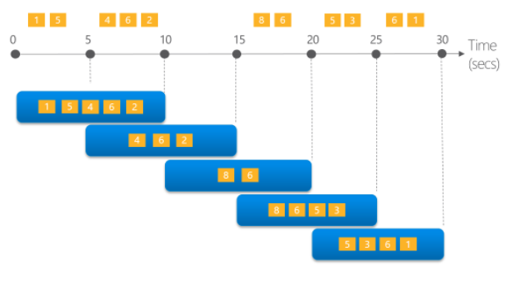
Stream Analytics
Typical architecture:
Issues to consider:
It provides window functions and can connect to Azure Machine Learning but for complex analytics data has to be dumped into database / data warehouse
In real world often we cannot connect to IoT devices – because service is provided by third parties or devices are hidden behind a demilitarized zone (e.g. national infrastructure) – so all we get is regular batch files
Therefore stream analytics may not always be the best option…
Azure IoT Hub
Stream Analytics
Azure Database
Machine Learning
Window
functions:
Hopping
Tumbling
Sliding
https://docs.microsoft.com/en-us/azure/stream-analytics/stream-analytics-window-functions

Slide 19
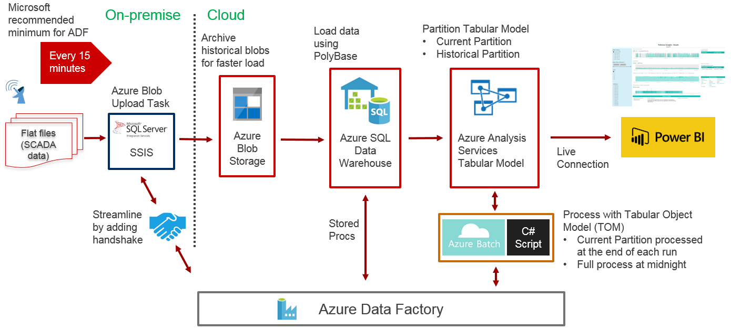
Alternative solution for near real-time analytics
3 key points to achieve near real-time:
Partitioned Tabular Model – process only current day partition during the day
Archive historical blobs (if files are small and many, may also need to merge files before uploading to Blob)
Handshake between SSIS and ADF
Added benefit of doing historical analytics alongside near real-time
(More details on this in my SQLBits 2017 presentation)
Process only a stream of data every 15 min
At midnight process monthly / historical partition

Slide 20
Side Question
If we were starting fresh, when would we use Azure Tabular Model, when we would use just PowerBI?

Slide 21
PowerBI Model vs Azure Tabular Model
Azure SQL Data Warehouse
Import / Direct Query
 | PowerBI Model | Azure Analysis Services Tabular Model
Pros | Low Cost With Import mode modelling functionality similar to Analysis Services | No size limit Can implement near real-time refreshes by partitioning Can scale up / down
Cons | Direct Query is slow so can’t be used in practice If used in Import mode, can only be refreshed 8 times per day (With PowerBI Premium this is unlimited, but there is additional cost to that) File size limit 1GB (With PowerBI Premium it is 10GB) Cannot be partitioned | Cost is high – use it only when it’s really required! B1: ~£234/month, S1: ~£1,104/month Additional development time and management of Azure Analysis Services
Azure Analysis Services
Live Connection
Azure Database
Import / Direct Query
PowerBI Connection Options
Import Mode: Data is imported into PowerBI – can be refreshed up to 8 times per day – has data volume and performance restrictions
Direct Query: No data is imported into PowerBI – refresh not required – has performance restrictions
Live Connection: Connect to Analysis Services where modelling and calculations are done – provides near real-time reporting – best for large amounts of data and high performance
Prices are North Europe region on 11/02/2018

Slide 22
Question #2
How to build a reporting system where users enter / view data using a complex Web App?

Slide 23

User Interaction
Web App should only interact with Azure Database
Summarised data from Azure Data Warehouse may be dumped into Azure Database
Azure SQL Data Warehouse
Azure Database
May also embed PowerBI into Web App
Azure Web App
Azure Data Factory

Slide 24
Second Phase Aug 2016 – Feb 2017
On-premise
Cloud
Major Development:
Near real-time IoT analytics using Azure Analysis Services
Azure Web App / Azure Database for ODI reporting
3 environments: Dev, UAT, Prod
Data Sources
Gateway Server
SQL Server
Attunity SQL Server Oracle Connector CDC
Azure Blob Storage
Azure SQL Data Warehouse
Azure Analysis Services
Tabular Model
Ellipse
Near real-time refreshes
FFP
Polybase
CRM
CAB
Dashboards
GWater
SSIS
Up to 8 refreshes per day
SCADA IoT Signal
Pollution Insights IoT v1
ODI Performance Commitments v1
Custom component
Waste Water Treatment Works IoT
Azure Data Factories
C#
Leak Detection
Waste Water ODI
Customer Leakage
Azure Web App (.NET)
Azure Database
Performance Commitments
Data Entry

Slide 25
Phase 3 (Mar 2017 – Dec 2017)

Slide 26
Questions
How do we do annotations & reference data management?
How do we do notifications?
So far we had only on-premise data sources… How do we upload data from sources such as web services and SFTP?

Slide 27
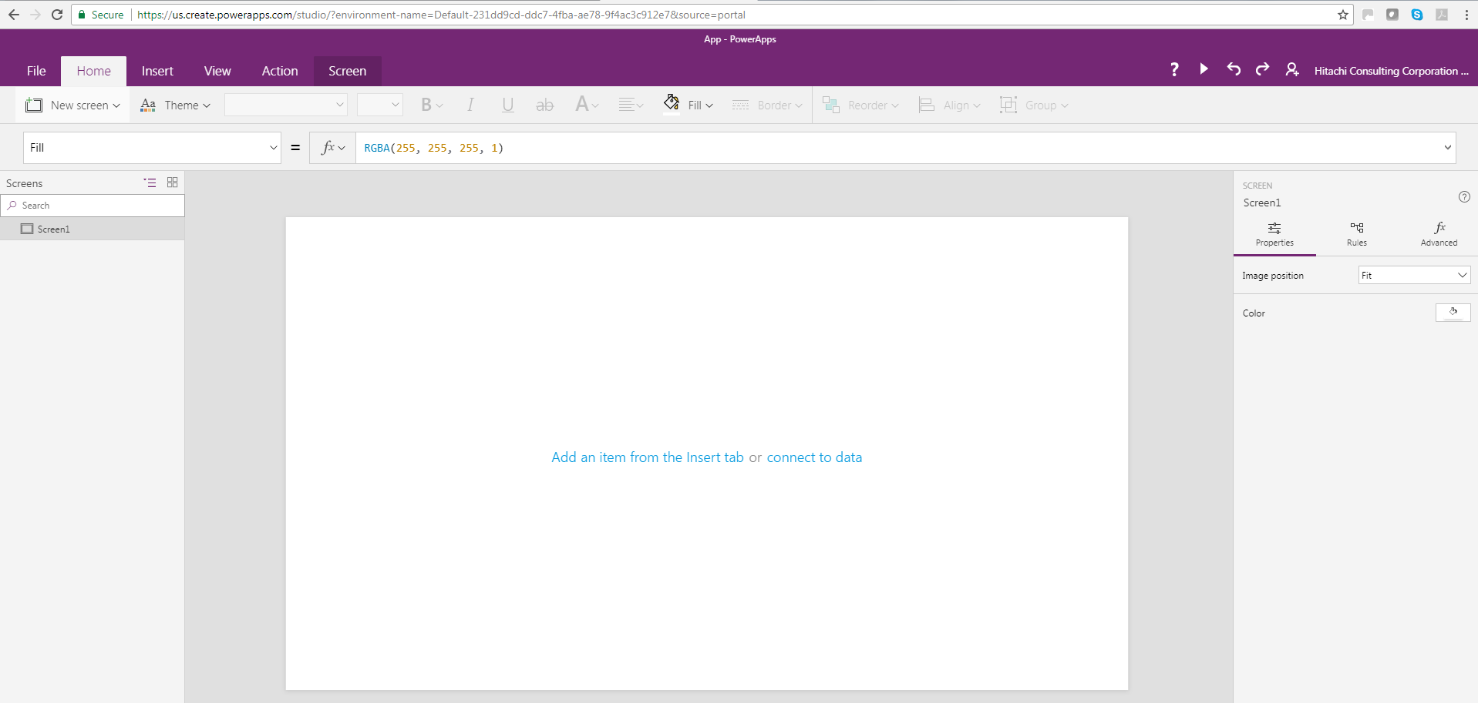
1. Annotations / Reference Data Management
PowerApps
Use it if a simple form is needed for annotations (insert, update, delete records from a table) or reference data management
Quick development time through web interface
As of January PowerApps Custom Visual for Power BI is available so form can be embedded in dashboard (However, it is still not possible to trigger refresh of dashboard through form)
Custom Web App
For more sophisticated apps
Link from dashboard to app for data entry
Azure Database
Azure SQL Data Warehouse
Azure Analysis Services
PowerApps
Azure Data Factory

Slide 28

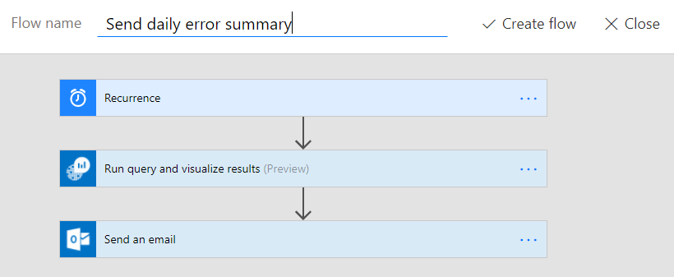
2. Notifications
Azure SQL Data Warehouse
Azure Database
Flow
Copy notification list into Database
Read List
Email notification about event with link to PowerBI dashboard for further investigation
Send email
Logic for deriving notifications
List of notifications
Mark as done
With Microsoft Flow it is easy to do
Alternatively write custom .NET App

Slide 29
3. Uploading data from non-on-premise sources
Not much point in landing the data on premise
Can use Azure Data Factory
Connectors: Web services, SFTP, Amazon Redshift, Oracle, SAP etc.
Otherwise use custom .Net code
Run using ADF + Azure Batch, or Web Job
Or a third party tool (e.g. Mulesoft)

Slide 30
Third Phase Mar 2017 – Dec 2017
PowerBI Audit Logs
On-premise
Cloud
Azure Runbook Powershell
Major Development:
Connect to Data Sources directly from ADF
More Application Azure Databases
PowerApps for simple forms
Flow for notifications
Data Management Gateway for data upload from on-premise to Blob
Express Route
Express Route
Output to other systems
IW Live
Data Sources
Upload data
Azure Blob Storage
Azure SQL Data Warehouse
Azure Analysis Services
Tabular Model
Ellipse
Gateway Server
SQL Server
Attunity SQL Server Oracle Connector CDC
FFP
Polybase
Near real-time
refreshes
CRM
Upload data
CAB
Dashboards
GWater
Pollution Insights IoT v3
SCADA IoT Signal
SSIS
Up to 8 refreshes per day
Upload data
ODI Performance Commitments v3
SCADA IoT Alarm
Data Management Gateway
Bathing Beaches
Upload data
Custom components
Waste Water Treatment Works IoT
Pmac IoT Logger
Azure Data Factories
C#
Leak Detection
Sample Manager
Waste Water ODI
Azure Databases
Customer Leakage
Hwm IoT Logger (API)
Usage Stats
Azure Web App (.NET)
Flow
i2o IoT Logger (SFTP)
Performance Commitments
Email Notifications
PowerApps
AppsDB
Data Entry
Reference Data Management
BeachLive
Azure External Websites
DMZ
Third party access to data

Slide 31
Further Decisions

Slide 32
Further Decisions
How do we coordinate multiple Azure Data Factories, Tabular Models, PowerBI dashboards accessing Azure DW when it is scaling up and down, and given that only 32 multiple concurrent connections are allowed?
How do we manage Dev-Test-UAT-Prod environments?
When do we need PowerBI Premium?

Slide 33
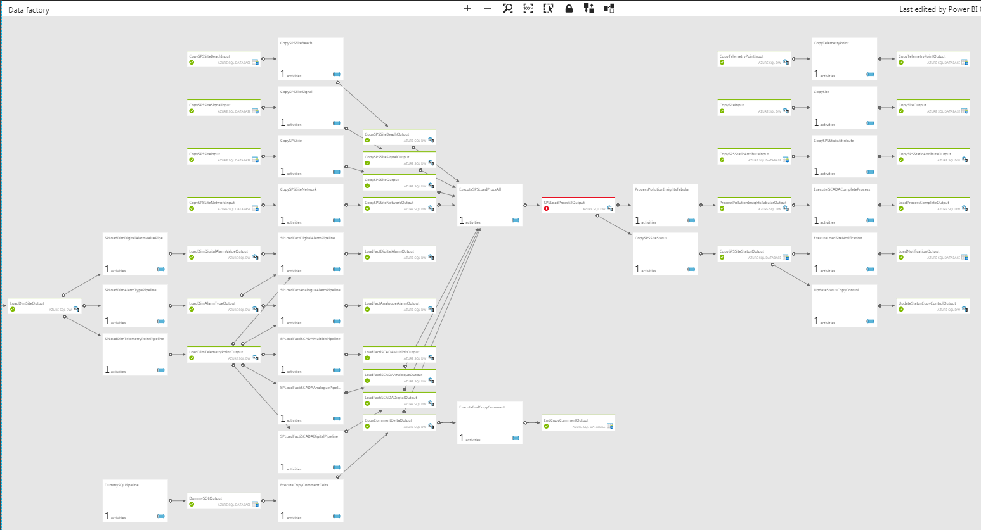
Azure Data Factory
ADF used for data movement and orchestration
Example ADF loading facts and dimensions, and processing tabular model (it is possible to simplify this by having a master proc to load facts and dimensions but then will not be parallelised):

Slide 34
Typical Azure Data Factory Operations
As solution grows, operations required may comprise of:
Process data in Azure Data Warehouse
Load data from on-premise to Blob Storage
Load data to Blob from sources such as web services, sftp, Azure Databases
Copy processed data from Azure Data Warehouse to Azure Database to be accessed by Web App
Process Azure Analysis Services Tabular Model
Scale up/down Azure Data Warehouse
Etc
→ So we will end up with multiple ADFs…
Azure Blob Storage
Azure SQL Data Warehouse
Azure Analysis Services
Tabular Model
On premise data source
Data Management Gateway
On premise data source
Web Service Data Source
SFTP Data Source
Azure Database
Azure Database
Azure Database

Slide 35
1.a. How to coordinate multiple ADFs?
How to coordinate multiple ADFs?
No functionality to have a master ADF
Therefore functionally ADFs need to be distinct
But if one ADF scales Azure DW up / down, Azure DW becomes unavailable, resulting in failures in other ADFs accessing Azure DW. So:
Either implement long retries on Azure DW operations so there is an interval between retries
"policy":
{
"retry": 3,
"longRetry": 5,
"longRetryInterval": "00:10:00"
}
Or use Azure Automation Runbook to stop/restart ADFs
In the basic architecture single ADF will be sufficient
As solution grows, single ADF difficult to manage, therefore will need multiple ADFs

Slide 36
1.b. Azure Data Warehouse – Resource Classes
Maximum concurrent queries in Azure DW is 32!
As number of concurrent operations on Azure Data Warehouse increases (i.e. multiple Data Factories, Tabular Model refreshes), to ensure predictable performance will need to manage resource allocation
Assign admins/users to Resource Classes
Dynamic Resource Classes (smallrc, mediumrc, largerc, xlargerc): allocate memory depending on current DWU
Static Resource Classes: allocated fixed memory
Best plan depends on what complete solution looks like
e.g. ADF solutions may run under a admin account with a large resource class, and Tabular Model refreshes may be done with a different admin account with a large resource class, to ensure they don’t block each other
https://docs.microsoft.com/en-us/azure/sql-data-warehouse/sql-data-warehouse-develop-concurrency

Slide 37
2. Managing Environments
Typically an organisation has one tenant
Within a tenant create subscriptions for each environment (or consider merging Dev with Test)
Subscriptions allow easy billing and access control
Resource Group is associated with a subscription
Resources in a group should have the same lifecycle
All resources may be placed within a group or may be separated
e,g. Database and Web App for a specific solution may be placed in a separate group
Hierarchy:
Enterprise
Account (Tenant)
Account (Tenant)
Dev Subscription
Test Subscription
Prod Subscription
Dev & Test
Subscription
Prod Subscription
Resource Group D1
Resource Group T1
Resource Group P1
Resource Group D
Resource Group T
Resource Group P
Resource Group D2
Resource Group T2
Resource Group P2
Azure Active Directory
Azure Active Directory

Slide 38
3. PowerBI Considerations
PowerBI Premium
Provides dedicated capacity
No restrictions on dataset refresh rate
Users who require read-only access (do not do self-service or collaborate)
Publish reports on-premise on PowerBI Report Server
Cost is high (e.g. around £4K for an organization with 500 users), therefore not suitable for a small organisation
PowerBI Pro
For users who require self-service and collaboration
https://docs.microsoft.com/en-us/power-bi/service-premium-faq
Essentially there are 2 options:
Small-to-medium organisations Get X number of PowerBI Pro licences, and other users will use free service
Medium-to-large organisations Get X number of PowerBI Pro licences, and consider getting PowerBI Premium
Prices are North Europe region on 11/02/2018

Slide 39
Other cool services
Azure Automation Runbook: schedule PowerShell and Python scripts to automate tasks
Logic Apps: Automate your workflows (Flow is built on this, and is a simpler version)
Azure Function: To run a simple piece of code
Cognitive Services: Image / Speech / Language processing algorithms to be used in apps and bots
Azure Data Lake Analytics: Process petabytes of data using U-SQL, R, Python and .NET
Cosmos DB: NoSQL (e.g. if you have json files)
HDInsight: Big Data Analytics using open source tech, Hadoop, Spark, Hive, Kafka, Storm, R

Slide 40
Last few things…
Contact: https://www.linkedin.com/in/mehmet-bakkaloglu-0a328010/
Hitachi Consulting is a platinum sponsor of SQLBits – please stop by our stand for more information
Would appreciate if you could complete the feedback form

Slide 41
Thank you

